Slide 1
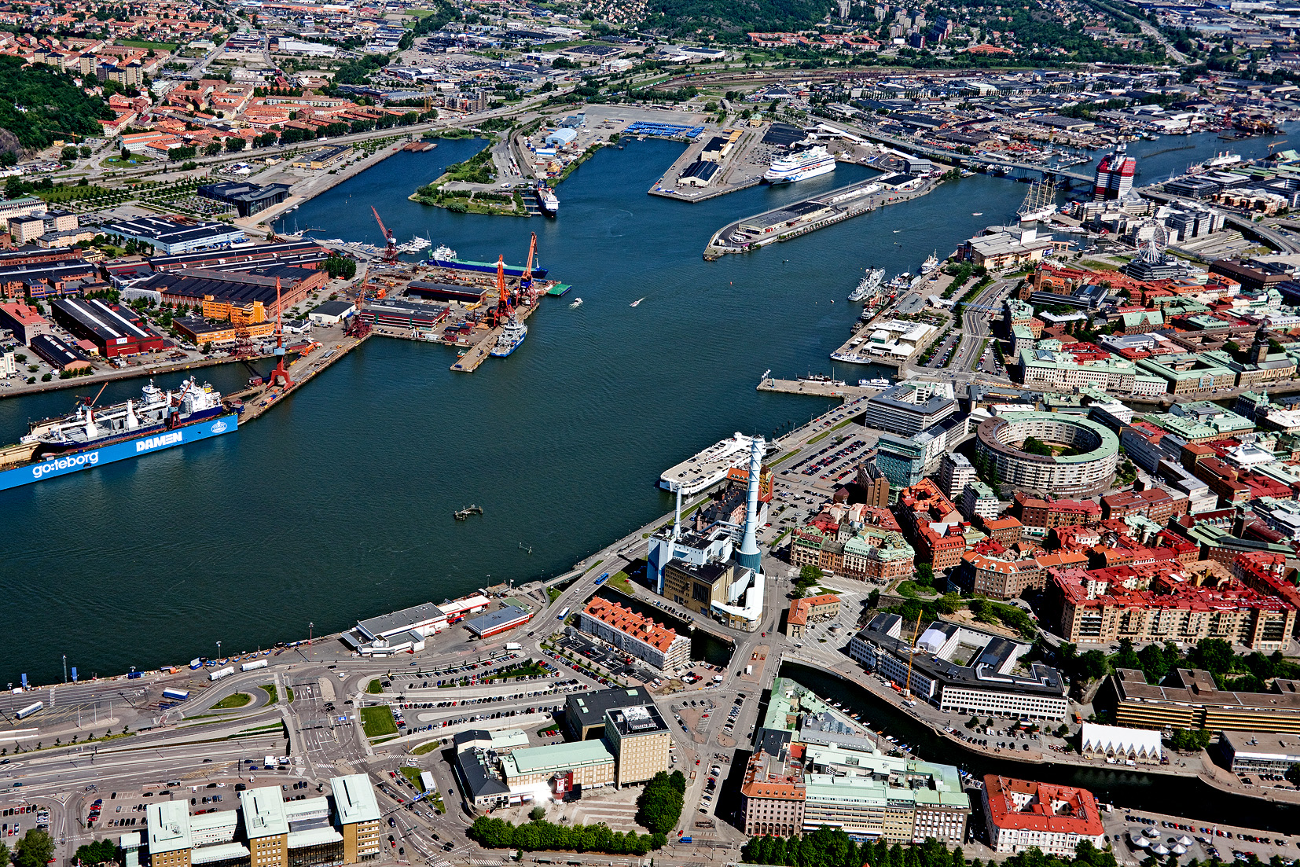
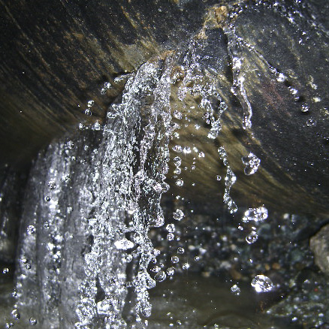
the international water association
Water Loss Specialist Group
best practices in water loss management

Slide 2

IWA’s vision and mission
Our Vision
A world in which water is wisely managed to satisfy the needs of human activities and ecosystems in an equitable and sustainable way.
Our Mission
To inspire change and service IWA members, the community of professionals concerned with water, external organisations and opinion leaders in being the international reference and global source of knowledge, experience and leadership for sustainable urban and basin-related water solutions

Slide 3
IWA helps bridge the chasm

Slide 4
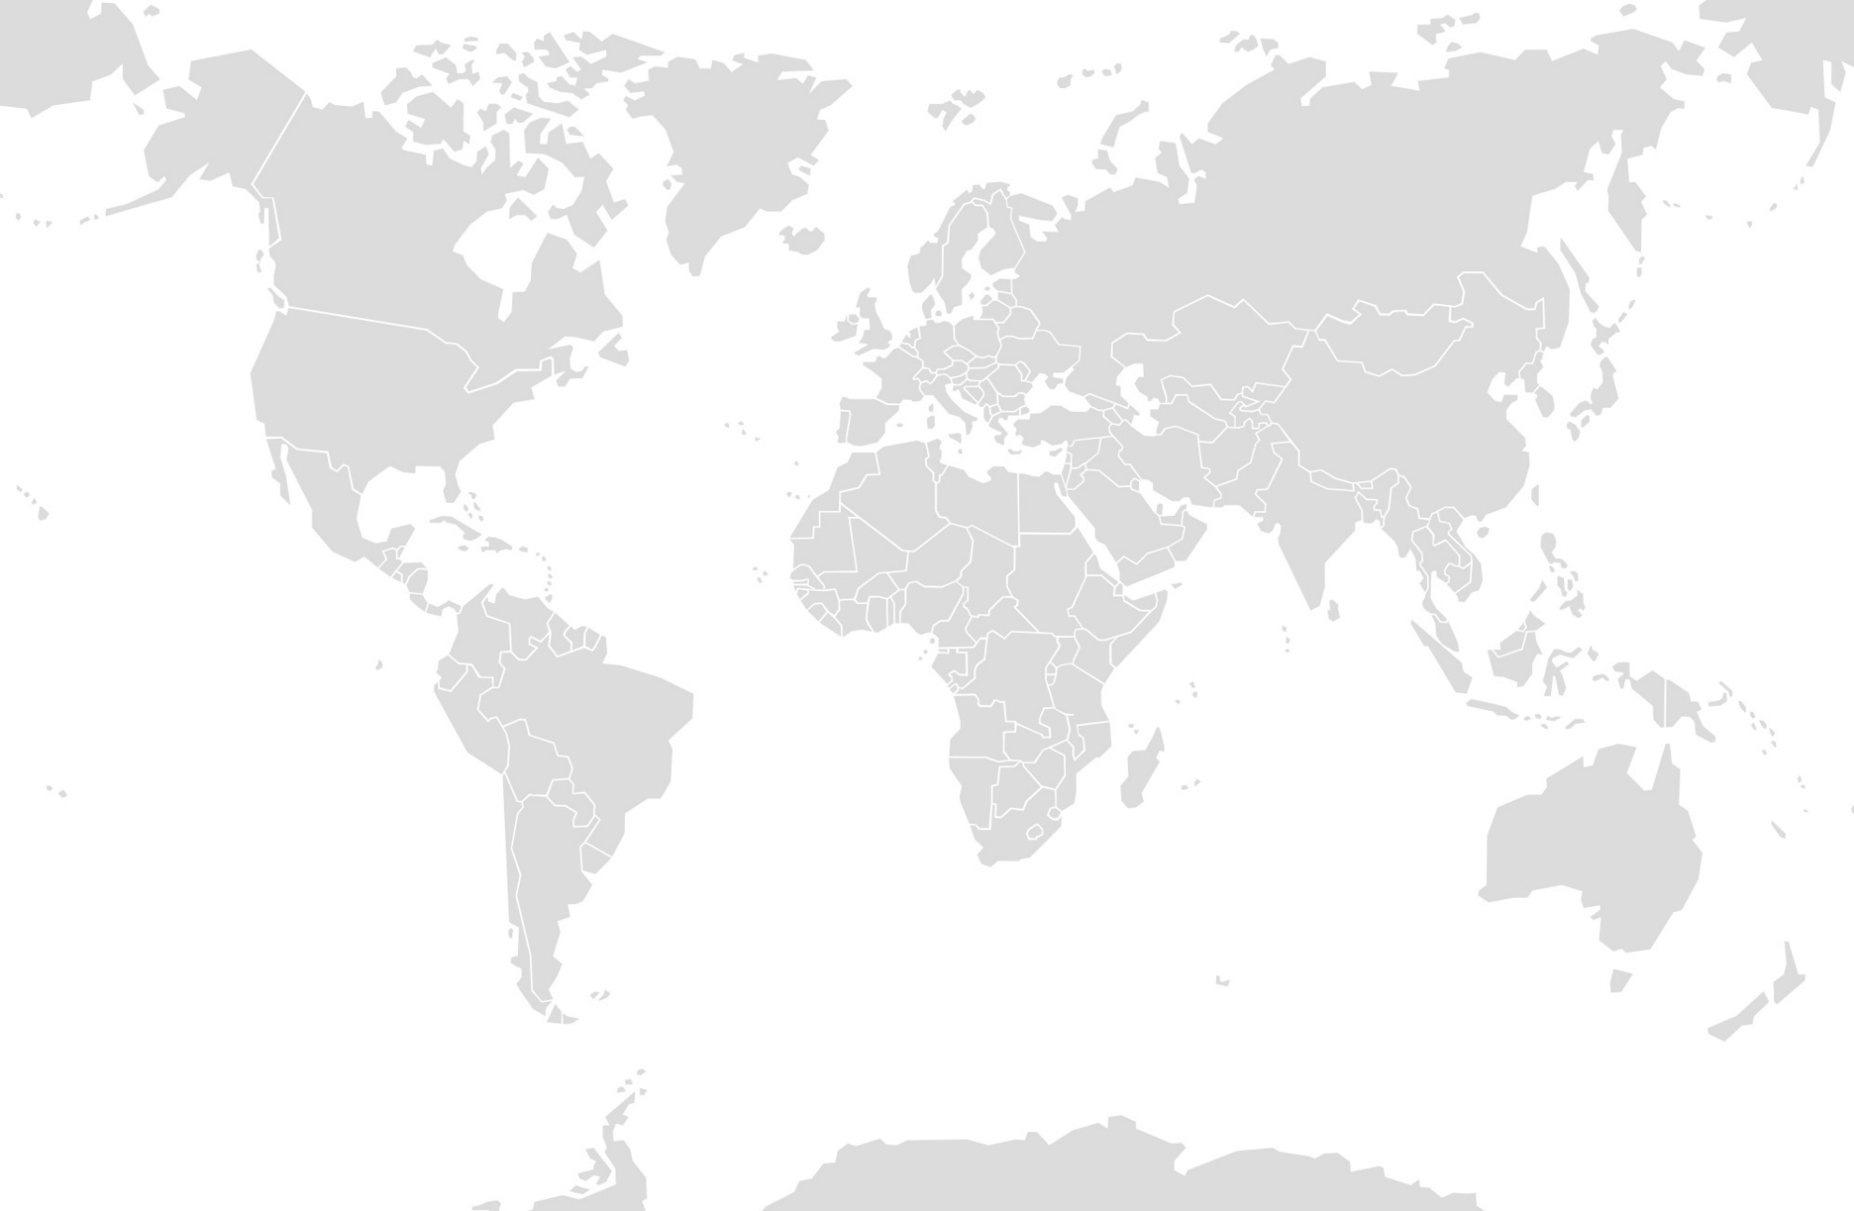
Global reach
Governing Members
University Members
Corporate Members
Individual Members

Slide 5
Water Loss Specialist Group

Slide 6
The team
Chair: Stuart Hamilton – UK
Secretary: Gary Wyeth – Thailand
Management Committee – 20 members 17 countries
Country Representatives – 15 (continuously increasing)
Over 1500 IWA Connect WLSG members
Over 3500 active members promoting Water Loss
Represented in over 60 countries

Slide 7
Previous conferences

Slide 8
Water loss specialist group - aim
“to provide leadership in the development of effective and sustainable international best practice in water loss management”
“to develop best practices in water loss management”

Slide 9
Key objectives and outline (1)
Introduce new and young talent to the WLSG
Encourage and promote gender balance across all activities delivered by the WLSG
Create relationships and sharing of knowledge with water Associations around the world
Build relationships with funding institusions, such as World Bank, to assist them in promoting and investing in best practices to reduce water loss

Slide 10
Key objectives and outline (2)
Investigate new best practices in water loss management
Update all existing documents & processes and distribute
Seek to promote new technologies from around the world
Promote regional conferences and awareness programs

Slide 11
deliverables
Distribute all knowledge gained by means of electronic communications
Promote all findings through conferences
Encourage free sharing of data
Share software and spreadsheets to allow everyone to benefit

Slide 12

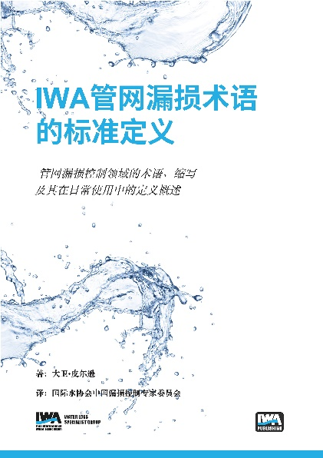


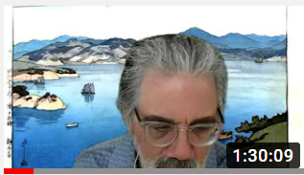
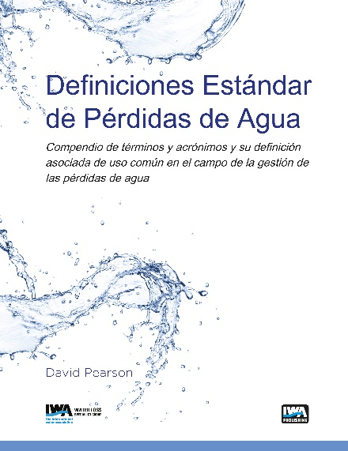
Books published, Spreadsheets developed and webinars delivered
WCB-EasyCalc☺
The free Carbon and Water Balance software Version 1.06 (21st Nov 2023)
Water System Improvement Calculator
Based on the Water System Improvement Matrix Methodology

Slide 13
WLSG message (1)
Many parts of the world are in real trouble, regarding water, due to lack of resources, groundwater and high leakage levels
Look after what you have, to prevent a situation in the future
No matter how good your system is or availability to clean water, control of your resources is imperative

Slide 14
Wlsg message (2)
Use the IWA Carbon and Water Balance to understand your NRW and calculate meaningful performance indicators
Do you have real losses or apparent losses?
Apparent losses are your next source of income
  Meter replacement program

Slide 15
Wlsg message (3)
Real losses are your next source of water
Produce a plan using the 4 IWA pillars for real loss reduction
  Pressure management
  Speed and quality of repairs
  Rehabilitation / infrastructure renewal
  Leakage location

Slide 16
WLSG Message (4)
Failure to monitor your system will end in failure
Don’t worry about being stupid – the simple things sometimes give the quickest and best results
Think to the future and plan, but don’t lose sight as to your current situation
Have a plan to climb the ladder to the next level

Slide 17
WLSG Message (5)
Think about investment you have and work within this budget – even no money does not prevent you from starting
Start at the beginning and don’t worry about what is happening around you
BUT MAKE A START

Slide 18
Take home message
Its not about being the best but being better than yesterday
Albert Einstein is credited for saying “The definition of Insanity is doing the same thing over and over again and expect a different result” – make that change that matters
Be as wild as you like looking for innovation – just be disciplined during the implementation
The WLSG is there to help and we are one big family – don’t be afraid to ask

Slide 19
How do you Join ?
Join via the connect page
Send either myself Stuart @ Shamilton@hydrotec.ltd.uk or Gary @ garywyeth@me.com an email and you will be a member
We encourage YWP participants
We encourage YWP taking lead roles in initiatives
We currently have a YWP heading up an initiative as chair of that initiative
Come and join us its free and a fun group

Slide 20
Thank you!
Stuart Hamilton: stuart.hamilton@miya-water.com
Gary Wyeth: garywyeth@me.com

