Slide 1
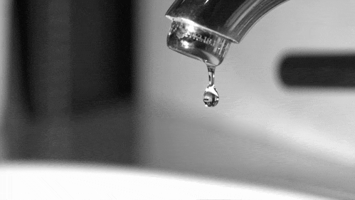
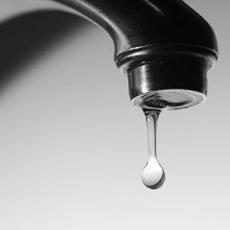

The Global
Non-Revenue Water Issue:
how reducing nrw can help the world mitigate and adapt to climate change

Slide 2
Global NRW Estimates
126 billion m³/year
346 million m³/day
77 litres per capita per day
USD 39 billion per year
Source - R. Liemberger & A. Wyatt

Slide 3
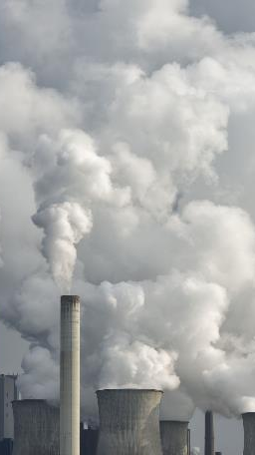
ESTIMATED GLOBAL CARBON EMISSIONS FROM TOTAL NRW
  187.2 million metric tonnes CO₂ / year
  513 thousand metric tonnes CO₂ / day
  0.6% of global CO₂ emissions
  Global CO₂ emissions
  1.9% from Aviation
  1.7% from Shipping

Slide 4
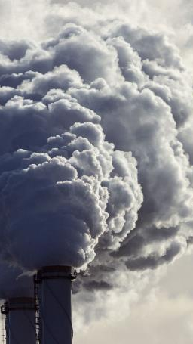
Leakage Emissions
Leakage Emissions are greenhouse gasses that are emitted as a result of Real Losses occurring in the network.
Leakage Emissions are traceable and measurable.

Slide 5
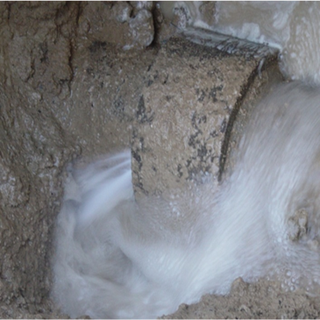
How do we reduce
Leakage Emissions
We already know how…………….. By reducing Real Losses!
When we reduce Real Loss, we are reducing the amount of energy and resources used in our water supply chain for water that is ultimately wasted.

Slide 6
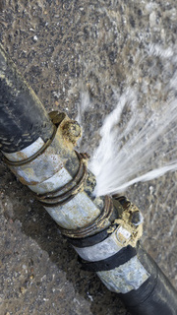
How do we reduce
Leakage Emissions
Where do we use energy in that supply chain?
  Water Acquisition (Abstraction)
  Water Treatment
  Water Transportation (Pumping)
  Reactive Repairs
  Leak Location

Slide 7


GLOBAL LEAKAGE RECOVERY
  Global NRW – 126 billion m³/year
  On average it has been found that 70% of NRW are Real Losses – 88 billion m³/year.
  These losses have a Carbon Footprint and are being produced and lost and are Carbon recoverable.
  Apparent losses is estimated at 30% of NRW, 38 billion m³/year, however not all of this can be accounted as carbon recoverable as some items of this water will be sold.
This Photo by Unknown Author is licensed under CC BY-SA-NC

Slide 8
Estimated global water production per source
Basic Water Source - no pumping and minimum chemicals | Traditional Water Systems – combination of pumping / treatment / chemicals | Desalination Sea Water Reverse Osmosis (Average) | Desalination Sea Water Reverse Osmosis (high) and plants run by fuel oil
10% | 60% | 20% | 10%

Slide 9
CO₂ in grams per m³ of water per water production source
Basic Water Source - no pumping and minimum chemicals | Traditional Water Systems – combination of pumping / treatment / chemicals | Desalination Sea Water Reverse Osmosis (Average) | Desalination Sea Water Reverse Osmosis (high) and plants run by fuel oil
30 g/m³ | 298 g/m³ | 3,170 g/m³ | 6,700 g/m³

Slide 10
Global CO₂ emission savings from leakage reduction
This equates to 0.4% of global CO₂ emissions
CO₂ SAVINGS METRIC TONS / YEAR
Basic Water Source | Traditional Water System | Desalinated Sea Water – Reverse Osmosis | Desalinated Sea Water – RO using Fuel Oil | TOTAL
264,600 | 15,770,160 | 55,918,800 | 59,094,000 | 131,047,560

Slide 11
So…. what does this look like ?
CO₂ OVERVIEW PER WATER SOURCE PER YEAR
Basic Water Source | Traditional Water System | Desalinated Sea Water – Reverse Osmosis | Desalinated Sea Water – RO using Fuel Oil | TOTAL
264,600 | 15,770,160 | 55,918,800 | 59,094,000 | tonnes per year
10% | 60% | 20% | 10% | % water source
30 g/m³ | 298 g/m³ | 3,170 g/m³ | 6,700 g/m³ | CO₂ g/m³
0.21% | 12.03% | 42.67% | 45.09% | % of CO₂

Slide 12

Which is equivalent to:
A plane annually circumnavigating the earth 52,419 times
Or
To offset the footprint annually planting 218.4 million hectares of trees – equivalent in size to a quarter of Brazil, the fifth largest country in the world.
To offset the Carbon Emissions from Leakage only, if no action is taken and leakage remains the same, the whole of the Earth’s land area will be planted with trees over the next 64 years.

Slide 13
where it all started
Paris agreement 2015
  At COP 21 in Paris, on 12 December 2015, Parties to the UNFCCC being nearly 200 countries reached a landmark agreement to combat climate change and to accelerate and intensify the actions and investments needed for a sustainable low carbon future.
  It also prescribes that Parties shall communicate their NDCs (plans) every 5 years and provide information necessary for clarity and transparency. To set a firm foundation for higher ambition, each successive NDC will represent a progression beyond the previous one and reflect the highest possible ambition.
  Main goals are
  Limit temperature rise 'well below' 2 C.
  First universal climate agreement.
  Helping poorer nations.
  Publishing greenhouse gas reduction targets.
  Carbon neutral by 2050.

Slide 14
NRW Reduction Strategy
Real / Physical Losses
Pressure management
Speed and quality of repairs
Potentially recoverable
Physical Losses
Active leakage control
Economic level of Real Losses
Unavoidable Annual Real Losses
Asset management
Current Real / Physical Losses
Notes:
Source: Farley, M (2008) The Manager’s Non-Revenue Water Handbook - A Guide to Understanding Water Losses

Slide 15
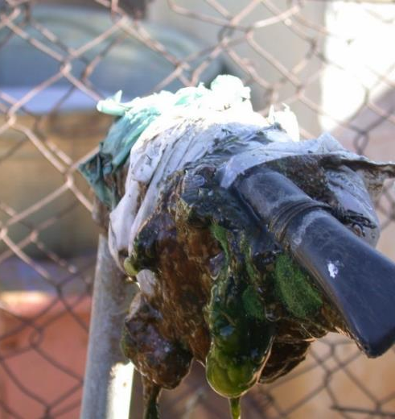
How does the carbon footprint reflect in the decision making when planning the repair or reducing real losses?

Slide 16
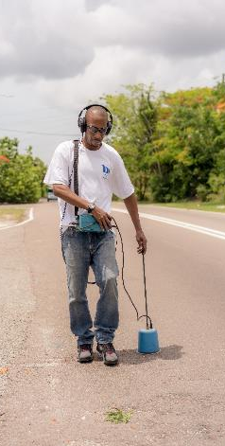
Active leakage control factors affecting Carbon
Listening on each stop tap
Must get to and from site
Don’t know if any leaks present in the region surveyed
Low footprint if area is surveyed by foot
Lift and shift of noise loggers
Movement of staff in vehicles doing lift and shift and follow up Active Leakage Control activities
Don’t know if any leaks present in the region surveyed
Permanent installed equipment
Once installed only go to alarms – reduced unnecessary vehicle usage
Satellite leakage
Only go to areas of Interest – reduced unnecessary vehicle usage

Slide 17
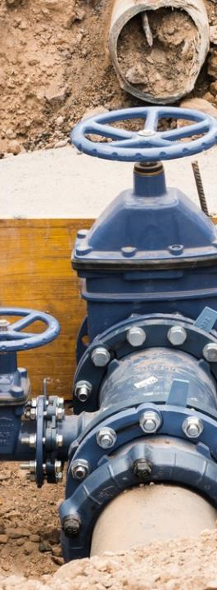
Asset Management factors affecting Carbon
Method of pipe installation
Open-cut
Bored / pipe-bursting
Ground type
Concrete / tarmac
Sand / grass
Material used
Metallic
Non-metallic
Life expectancy 30 - 60 years
Service pipe
Material
Renew or use existing

Slide 18

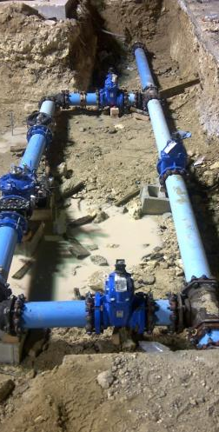
Pressure Management factors affecting Carbon
Installation of PRV and servicing valves
Single time installation
Type of pressure management
Chose right type of installation for best results
Lowest cost on carbons once installed
Reduces losses without needing to visit site
Controlled remotely and serviced annually

Slide 19
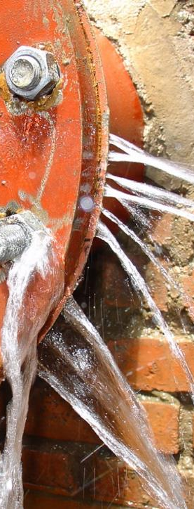
Speed and quality of repairs factors affecting Carbon
Repair or replace
Repair quality
Quality of fittings used
Run time of leak

Slide 20
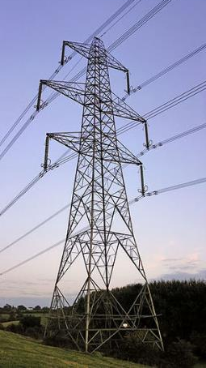
Other factors to consider
How is electricity produced
    Fuel Oil
    Renewable – Wind / Solar / Geothermal
    Natural Gas
    Coal
    Nuclear
Increase in cost of fossil fuel
Resilience to catastrophic failure
    Can you get fuel oil onto the island
    Storage capacity for fuel oil
Storage capacity of water
    How long can you survive with high NRW
    Reducing Real Losses can help countries adapt to impacts of climate change

Slide 21
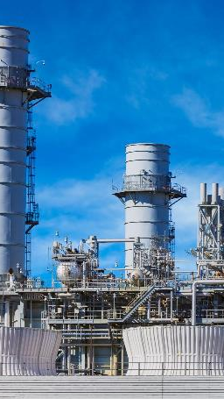
How can I become Carbon Neutral by 2050?
  Carbon footprint must be reduced
  Increase shift away from fossil fuel
  Extra storage facility
  Ability to survive a catastrophic failure
  Resilience insurance needs
  Look at the bigger picture
  What is your biggest usage of Carbon?

Slide 22

As a utility, reducing NRW will help you become carbon Neutral by 2050
The funding of NRW can unlock many climate financing options
Climate funding options are widely available and currently not being used to reduce NRW
This is a widely untapped source and Govt., by necessity, must look at reducing carbon emissions
Sources of finance include
    Green Climate Fund
    IFI funding
    Commercial banks
    Private operator

Slide 23
How are you going to make a difference
  The problem isn’t financing, it’s the will from the country and utility, but now there is a commitment to abide to the Paris agreement
  Common sense is now a priority, and a start must be made
  Begin changing the way we live for not only ourselves but our children and grandchildren – we can do our bit to help correct mistakes made in the past
  We cannot change the world, but we can change a small part of it and reduce NRW and carbon emissions
  Where will you be on this journey:
      A leader?
      or
      A follower?

Slide 24
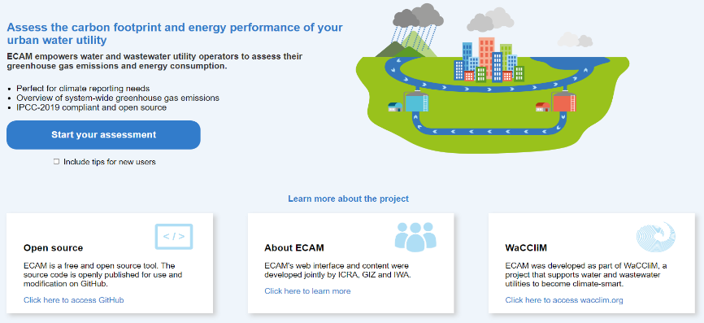

http://wacclim.org/ecam/
https://wacclim.org/

Slide 25
Thank you
Stuart Hamilton
Bambos Charalambous
stuart.hamilton@miya-water.com
bcharalambous@cytanet.com.cy
Acknowledgements:
Sara-Jade Govia sarajade.govia@gmail.com
Nils Janson njanson@km-advisorsllc.com
Lindsay Burkhard lburkhard@km-advisorsllc.com
John Ikeda john.ikeda@castalia-advisors.com

